Slide 1

Investigating the differences between the transcriptomes of parental and Venetoclax Resistant mantle cell lymphoma cells
Kai Lawson-McDowall
16th December 2020

Slide 2
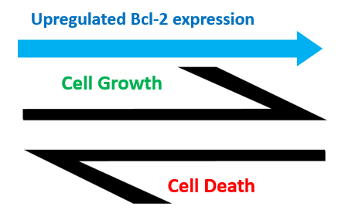
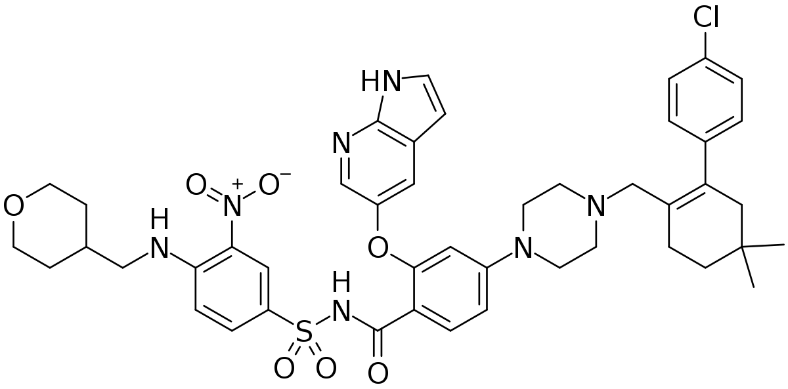
Background
Acquired resistance in cancers is responsible for death in up to 90% of cases
Venetoclax – treats B-cell lymphoma like mantle-cell lymphoma by inhibiting BCL2 which increases apoptosis and slows the cancers progression
Normally, BCL2 promotes promoting cellular survival by inhibiting pro-apoptotic proteins
Mantle cells develop resistance through transcriptional adaptations, and enter a drug-tolerant “persister” state (DTP)
The DTP cells act as a source for populations of drug tolerant cell populations (DTEP), which considerable barrier to successful therapy and recovery
Venetoclax Sensitive Parental Cells
Venetoclax Resistant Subpopulation
●●●●●●●●●●●●●●●●●●●●●●●●●●●●●●●●●●●●●●●●●●●●●●●●●●●●●●●●●●●●●●●●●●●●●●●●●●●●●●●●●●●●
●●●●●●●●●●●●●●●●●●●●●●●●●●●●●●●●●●●●●●●●●●●●●●●●●●●●●●●●●●●●●●●●●●●●●●●●●●●●●●●●●●●●
Venetoclax Exposure
Time
●
Venetoclax Resistant Cells in a Drug-Tolerant “Persister” State
Notes:
Acquired drug resistance is a major problem in cancer therapies, Drug resistance and the resulting ineffectiveness of the drug treatment are responsible for up to 90% of the cancer related deaths (Xuan et al., 2019). With the majority of cancer drugs, after initially killing a vast proportion of the tumour cells, a small sub-population of cancer cells can remain resistant to drug actions. It is thought that this resistance arises via mutations, epigenetic and transcriptional changes, and as a consequence of tumour heterogeneity.
One example of a drug which faces this problem is Venetoclax (which is shown at the the bottom right) which is used in the treatment of several cancers including B-cell lymphomas like mantle cell lymphoma. Venetoclax binds to the B-cell lymphoma 2 (Bcl-2) family of proteins, which although broadly function as apoptotic regulator, specifically act as anti-apoptotic factors in mantle cell lymphoma,allowing these cancerous cells to resist cell death. Generally, Venetoclax’s inhibition of BCL2 results in cancer cell death and slows the rate of disease progression. As mentioned, individual cells develop resistance to venetoclax by enter a drug-tolerant “persister state” and can then act as a reservoir to produce an actual population of drug tolerant cells known as drug tolerant expanded persisters. These serve as the major barrier to successful therapy and are illustrated below
**NOT FINAL - will give final check on monday.

Slide 3
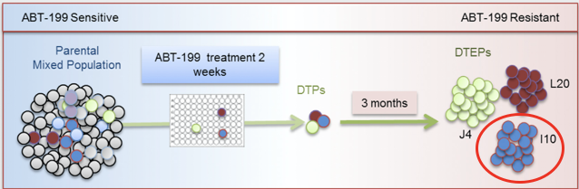
Background
Zhao et al generated a venetoclax sensitive parent cell line (PAR) and Venetoclax resistant cell line (I10). Venetoclax is a small-molecule, specific inhibitor of BCL2.
RNAseq analysis was conducted to assess how the transcriptomes of the genetical sensitive parental cells and the derived resistant cells differed.
Computational analysis to define which genes differed most significantly in their expression
Provided initial insight into how differential gene expression leads to resistance, revealing potential drug targets, and a foundation for drug development on venetoclax-resistant mantle cell lymphoma cells.
Notes:
Exploring this particular problem was the focus of a recent paper by Zhao et al., 2019, who generated resistant mantle cell lymphoma (MCL) derived cell lines by exposing a sample of MCL cells to venetoclax and compared them to parent MCL cells.
From this, they conducted an RNAseq analysis to compare how the transcriptomes of the sensitive parental cells and the derived resistant cells differed.
In this presentation, our aim was to firstly define the broader transcriptional differences between the parental and resistant cell lines, define the most differentially expressed genes and pathways, and then try and gage their biological relationship and relevance to MCL and BLC2. And in doing so, lay groundwork for future work for identify and developing drug targets.

Slide 4

Methods
FastQC – Initial Quality Control of raw RNA seq data such as per sequence GC content and overrepresented sequences.
TrimGalore - Removal of Standard Illumina Adapters.
Salmon - Quantification of RNA-seq data transcripts was conducted. The salmon index was conducted by building an index using the Gencode human transcriptome (version 35).
DESeq2 - Tested for statistically significant differential expression from quantified RNA-seq and visualization of this data
topGO - Gene Ontology (GO) analysis - Conducted a GO enrichment analysis for our three parental and three venetoclax resistant cell lines using statistical tests (Kolmogorov-Smirnov test).

Slide 5
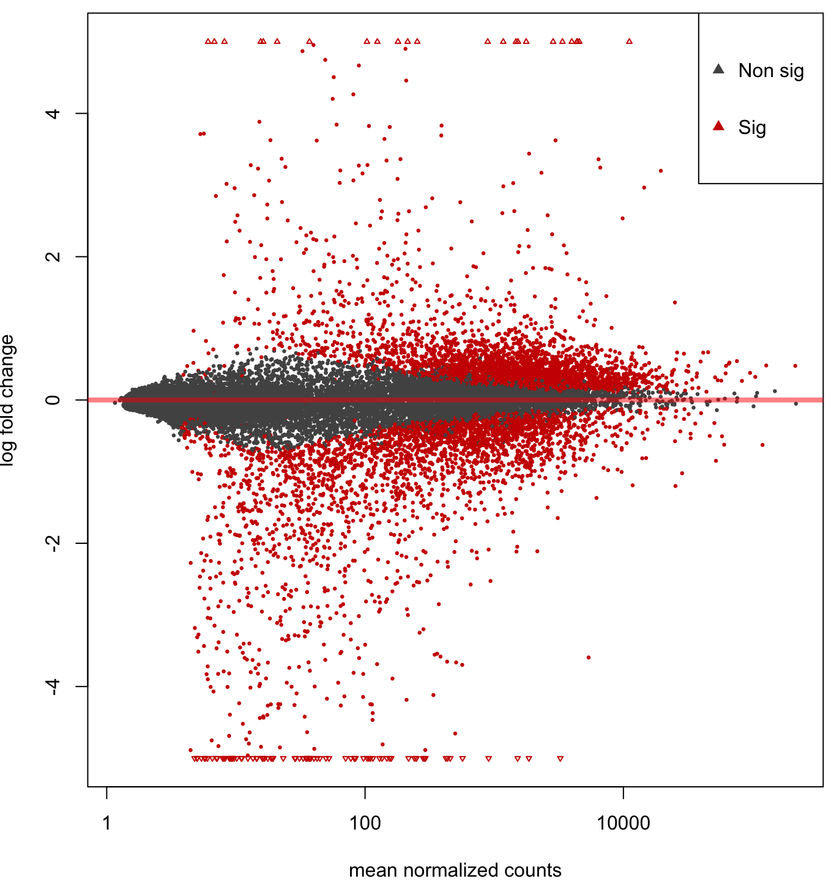
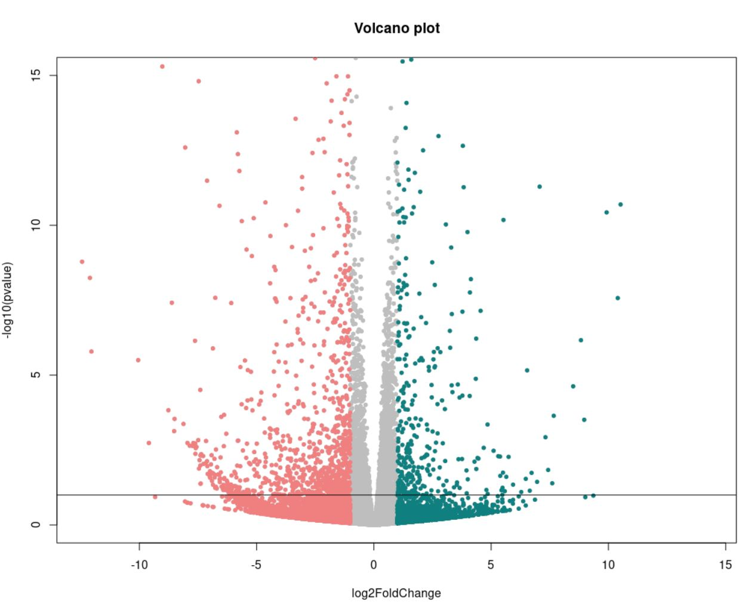
Results: Differential Expression Analysis with DESeq2
17,990 genes had non-zero read counts.
3290 (18%) of these genes were upregulated
3061 genes were downregulated (17%) at an adjusted p-value > 0.1 (Log2 Fold Change > 0)
No outliers or low counts were recorded (0.0%)
MA plot
Volcano plot
Notes:
The purpose of DEseq2 was to show which genes are differentially expressed between the Venetoclax resistant cell lines when compared to the parental cells lines. So say DEseq2 results
DESeq2 normalizes the counts of mapped reads for features like sequencing depth and gene length, and produces a mean of normalized counts for each gene, this is the x axis in the MA plot - which is plotted against differential expression in the form of a log2 fold change on the y-axis. Anything below the X-axis is downregulated and upregulated in the resistant cells with respect to the parent cells, with red points indicating those significantly so.
The volcano plot on the scales the significance values (Y-axis) against fold change (x-axis) and so informs us about the significance of the results. Here the red shows downregulated and the blue shows upregulation, the red-line shows the significance threshold (Adjust P-value 0.1)

Slide 6
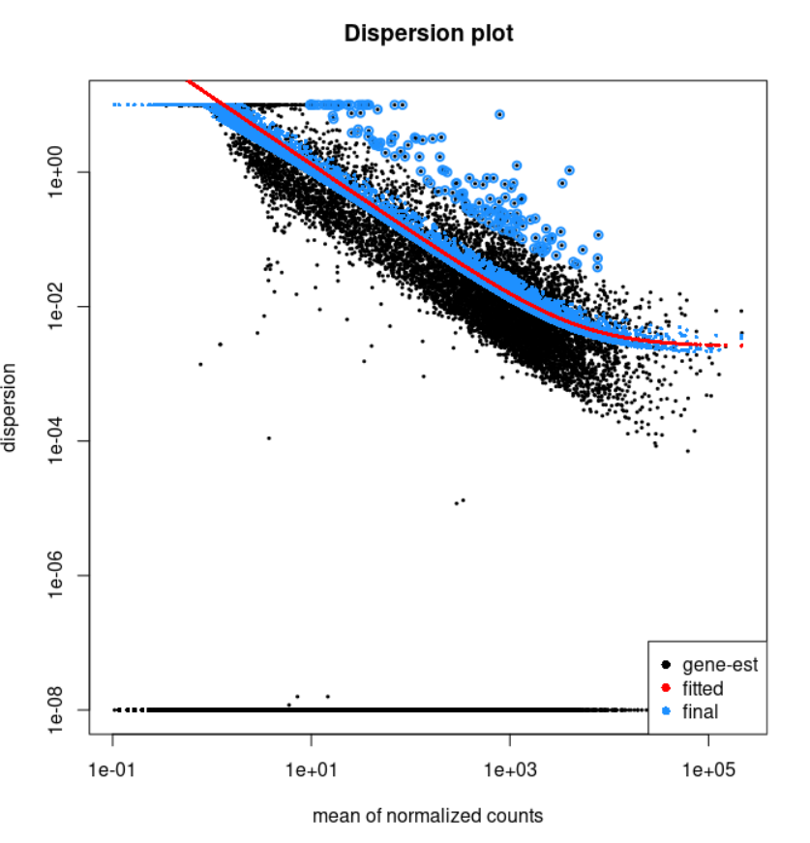
Gene-wise dispersion
DEseq 2's dispersion estimates are inversely related to the mean, and directly related to variance. I.e. higher mean counts have lower dispersion and vice versa.
DESeq2’s Shrinkage method is especially good for reducing false positives.
The data scatters evenly around the curve, with the dispersion decreasing with increasing mean expression levels. Indicating that the data is a good fit for the DEseq2 model.
Notes:
We also quantified dispersion, which measures the variability in the data. DESeq2 uses an algorithm measurement which inversely relates the mean and the variance of the data.
Here, a 1 x 10^-2 dispersion means 10% variation around the mean expected across biological replicates. So a higher mean of normalized counts should have lower dispersion and vice versa.
Each black dot is a gene and each blue dot is a prediction of the variation expected from that gene. And the red line is the expected dispersion for genes with a given expression strength.
Overall, as we see the data generally scatter around the curve and expect dispersion to decrease with the mean, this means our data is a good fit for our DEseq2 model above.

Slide 7
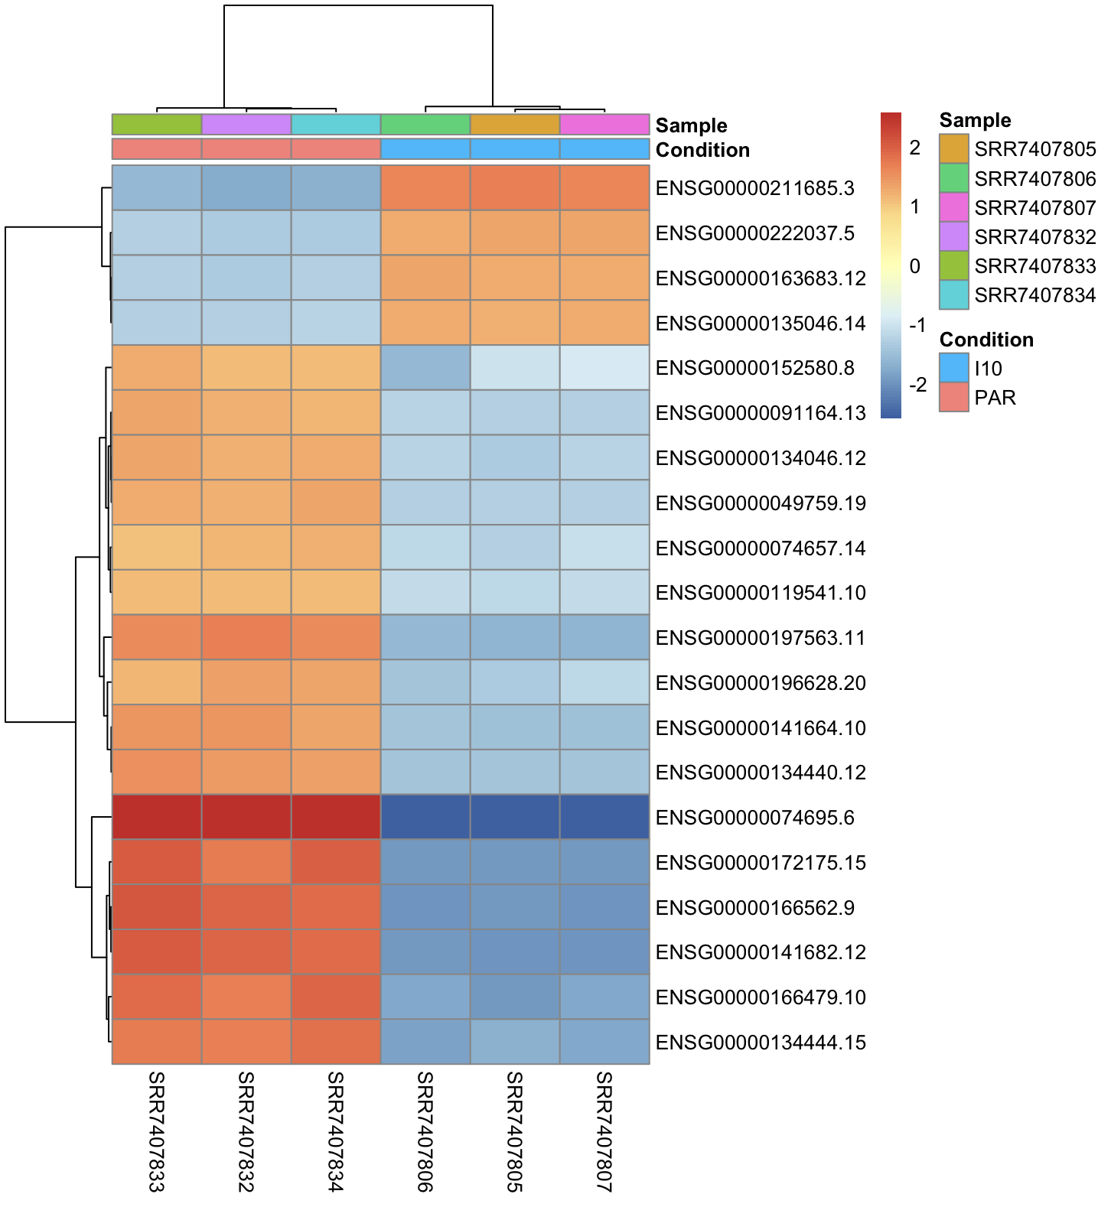
Most differentially expressed genes between samples and conditions
Heatmap showing gene clustering of the top 20 differentially expressed genes between parental and venetoclax treated cells.
4 genes were upregulated in treated cells and 16 downregulated
Further investigation showed the top 5 differentially expressed genes to be:
TXNL1
KDSR
VPS4B
MBD2
NARS1
IGLC7
IGLC6
SMIM14
ANXA1
IGSF10
TXNL1
MBD2
NEDD4L
ZNF532
VPS4B
PIGN
TCF4
ZCCHC2
NARS
LMAN1
MALT1
SEC11C
PMAIP1
TMX3
KIAA1468
Parental
Venetoclax Resistant

Slide 8
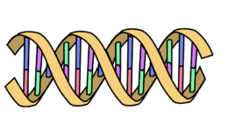
Gene biology
TXNL1
Plays a role in redox and oxidative stress; dysregulation may cause loss of oxidative stress-related apoptosis. Previous research has shown its upregulation in mantle cell lymphoma.
KDSR
Proto-oncogene; strongly upregulated in a variety of cancers. This gene is immediately upstream of BCL2, and its upregulation correlates to upregulation of BCL2. Furthermore, a chromosomal rearrangement involving this gene is a cause of follicular lymphoma.
VPS4B
Involved in multivesicular body transport via the ESCRT-III complex. Role in numerous cancers but not significantly linked to lymphomas.
MBD2
Binds to methylated DNA and aids in the mediation of gene silencing. Associated with several cancers, with MBD2 down-regulation associated with lymphoblastic leukaemia.
NARS1
Catalyses attachment of asparagine to tRNA. Upregulated in primary lung adenocarcinoma and identified with a potential to promote metastasis and growth of cancer cells.
Notes:
Resources used include UniProt, Human Protein Atlas, …
TXNL1 Reference: Farfsing et al., 2009 - Gene knockdown studies revealed CCDC50 as a candidate gene in mantle cell lymphoma and chronic lymphocytic leukemia
MBD2 Reference: We have previously identified PRMT5 overexpression to be relevant to MCL pathogenesis and shown it to work concertedly with MBD2 to silence genes with anti-cancer and immune modulatory activities

Slide 9
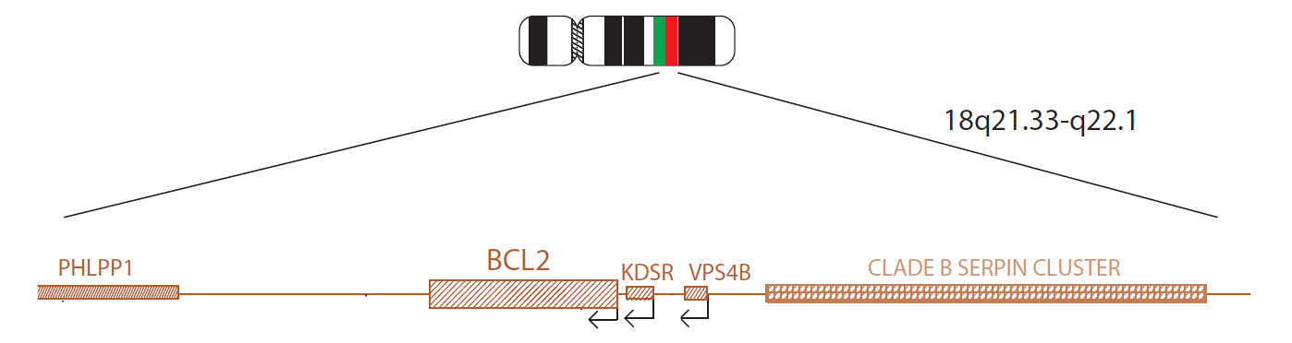
Significance of the top differentially expressed genes
BCL2 is a potent proto-oncogene, often transcriptionally enhanced in lymphomas via copy number amplification of its resident chromosome region 18q21.
However, BCL2 is also the inhibitory target of Venetoclax; therefore, when challenged, the overexpression of BCL2 ceases to provide an anti-apoptotic effect. This leaves a resistant population which doesn’t rely upon BCL2 to evade apoptosis, and instead relies on increased expression of genes such as MCL-1.
The genomic locations of the top 5 most differentially expressed genes all fall within the 18q21 region. This could indicate that the resistant strains lack the amplification of 18q21.
While testing this is beyond the scope of our analysis, this does mirror the results of Zhao et al.. which suggests the loss of 18q21 amplicons

Slide 10
Go Term Enrichment
Enrichment analysis by testing the over-representation of GO terms from all differentially expressed genes using performed using Kolmogorov-Smirnov test:
Gene Ontology was based on biological process.
11,857 genes were annotated with GO terms.
3,519 Significant genes were identified.
5,933 GO terms scored, with 748 terms with p < 0.01
Minimum of 10 genes annotated to each GO node.
5,915 Nontrivial nodes.
Notes:
The Gene Ontology (GO) provides a system for hierarchically classifying genes into terms organized in a graph structure termed an ontology. The terms here were grouped based on biological process, which describes the larger cellular or physiological role carried out by the gene coordinated
Enrichment analysis consists of applying statistical tests to verify if genes of interest are more often associated to certain biological functions than what would be expected in a random set of genes. In this over-representation analysis, we determine the significance of the overlap between our differentially expressed genes and gene set using a Kolmogorov-Smirnov Test. If the significance is high the overlap between our list of genes and the gene set is bigger than what we would get by randomly selecting gene lists with the same number of genes
The nontrivial nodes are those GO categories which have at least one significant gene annotated.

Slide 11
Top 10 biological processes
 | GO.ID | Term | Annotated | Significant | Expected | Rank in classic Fisher | Classic Fisher | KS | weight
1 | GO:0019221 | cytokine-mediated signaling pathway | 585 | 236 | 173.62 | 38 | 1.1E-08 | 6E-08 | 1.9E-08
2 | GO:0002444 | myeloid leukocyte mediated immunity | 444 | 182 | 131.77 | 51 | 1.5E-07 | 3.6E-07 | 1.5E-07
3 | GO:0060548 | negative regulation of cell death | 714 | 272 | 211.91 | 58 | 4.1E-07 | 2.7E-06 | 3.9E-07
4 | GO:0043299 | leukocyte degranulation | 427 | 174 | 126.73 | 60 | 4.5E-07 | 7.6E-07 | 4.5E-07
5 | GO:0002479 | antigen processing and presentation of e... | 68 | 40 | 20.18 | 62 | 5.3E-07 | 3.6E-06 | 5.3E-07
6 | GO:0006984 | ER-nucleus signaling pathway | 51 | 32 | 15.14 | 69 | 9.8E-07 | 1.3E-06 | 9.8E-07
7 | GO:0006955 | immune response | 1469 | 579 | 435.98 | 2 | 9E-18 | 6.9E-19 | 1.4E-06
8 | GO:0002275 | myeloid cell activation involved in immu... | 432 | 175 | 128.21 | 65 | 6.6E-07 | 1.2E-06 | 1.9E-06
9 | GO:0050853 | B cell receptor signaling pathway | 73 | 41 | 21.67 | 82 | 2.1E-06 | 3.1E-06 | 2.1E-06
10 | GO:0022613 | ribonucleoprotein complex biogenesis | 433 | 182 | 128.51 | 41 | 1.8E-08 | 6.2E-14 | 3E-06
Notes:
4 different algorithms, we used weight. More conservative, fewer false positives than classic; miss fewer true positives. Elim same but misses more true positives.

Slide 12
Top 5 differentially expressed pathways
Cytokine-mediated signalling pathway
A series of molecular signals initiated by the binding of a cytokine to a receptor on the surface of a cell, and ending with regulation of a downstream cellular process, e.g. transcription.
Myeloid leukocyte mediated immunity
Any process involved in the carrying out of an immune response by a myeloid leukocyte.
Negative regulation of cell death
Any process that decreases the rate or frequency of cell death. Cell death is the specific activation or halting of processes within a cell so that its vital functions markedly cease, rather than simply deteriorating gradually over time, which culminates in cell death.
Leukocyte degranulation
The regulated exocytosis of secretory granules by a leukocyte.
Antigen processing and presentation of exogenous peptide antigen via MHC class I (TAP-dependent)
The process in which an antigen-presenting cell expresses a peptide antigen of exogenous origin on its cell surface in association with an MHC class I protein complex following intracellular transport via a TAP (transporter associated with antigen processing) pathway.
Notes:
Cytokine-mediated cell signaling pathway - i.e can lead to modification of what genes are transcribed (upreg / downreg)
IL-2, IL-4, IL-7 and IL-15 led to a significant increase in Bcl-2 and a reduction in cell death rates
Myeloid leukocyte mediated immunity
Anti-tumor immunity: Myeloid leukocytes control the immune landscape
Myeloid cells with antigen-presenting capabilities can be co-opted by tumors to promote malignant progression
Negative regulation of cell death
decreases the rate or frequency of cell death, which is a hallmark of cancer
Leukocyte degranulation
Degranulation process where cell releases anti-microbial cytotoxic molecules from intracellular vesicles called granules
Neutrophils can directly kill or exert pro-tumorigenic activities by producing factors which promote angiogenesis and metastasis.
Antigen processing and presentation of exogenous peptide antigen via MHC class I, TAP-dependent
expression of exogenous peptide antigens (B7-H1) leads to inhibited T-cell killing mantle cell lymphoma cells

Slide 13

Conclusions
The differences between the transcriptomes of the sensitive ‘parental’ cells and the derived resistant cells were defined, with 3290 of these genes were upregulated and 3061 genes were downregulated (p>0.1).
The major difference between the parental and resistant cells appears to be downregulation of genes clustered at 18q21; this may indicate loss of amplification of this region. These findings appear to be consistent with those of Zhao et al.
These genes clustered at 18q21 were all shown to contribute to different cancers, 3 in lymphomas and TXNL1 specifically in mantle cell lymphoma.
As may be expected, the most differentially affected processes are linked to cellular signalling, prevention of cell death and immune evasion, all of which are hallmarks of cancer.

Slide 14


Future work
Explore the biological function of the top 5 differentially expressed genes, their relationship to BCL2 (through tools such as Kegg) and isolate if the effect of their up or down regulation confers resistance to Venetoclax.
Rerun the GO enrichment analysis using different TopGo algorithms (Elim and Classic) to determine if this changes the 5 most differentially pathways.
Obtain the list of genes corresponding to each GO term and determine which genes contribute the most to each affected process.
Limitations
KDSR did not appear in the heat map of the top 20 genes, indicating some sort of analytical error
Significance was ranked using topGO’s weight algorithm (which accounts for the GO hierarchy) and KS statistic. However, the use of alternative topGo algorithms (e.g. Classic or Elim) and different statistic such as Fisher’s Exact test might have changed the rankings.
Notes:
algorithms determine the relevance of Gene Ontology groups from microarrays.
Classic relies on the Fisher’s Exact Test Statistic
Elim relies on the KS test

Slide 15
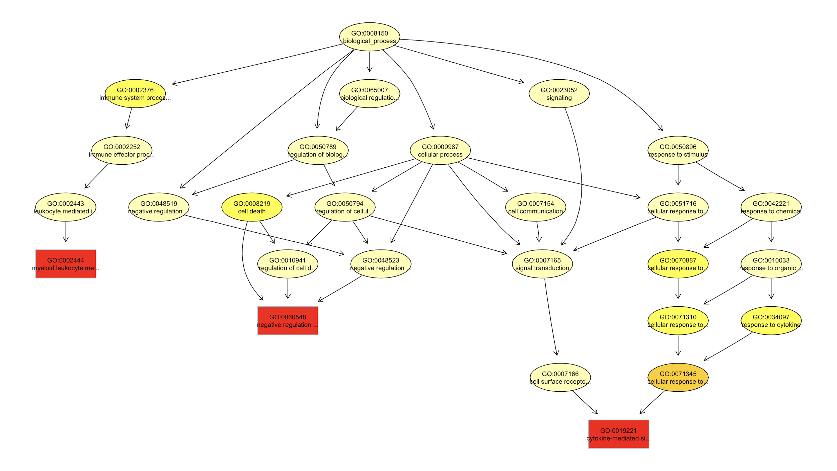
Appendix - GO subgraph with top 3 nodes
Notes:
The subgraph induced by the top 3 GO terms identified by the classic algorithm for scoring GO terms for enrichment. (by weight k-s test pval)
Boxes indicate the 3 most significant terms. Box color represents the relative significance, ranging from dark red (most significant) to light yellow (least significant). Black arrows indicate is-a relationships and red arrows part-of relationship

